Slide 1

Problem Statement Title- AI-POWERED SYMPTOM CHECKER
Theme- Healthcare
Team Name- SYNTAX SQUAD
Team Leader- Kanak Raj Arora

Slide 2
AI Symptoms Diagnosis System
MEDI CHECK
Problems
Insufficient access to Medical Expertise
Misdiagnosis and Overlooked Symptoms
Long Wait Times in Clinics
High Healthcare Costs
Lack of Health Literacy
Inefficient Symptom Assessment with existing systems
Limited Use of Technology in Initial Assessment

Slide 3
AI Symptoms Diagnosis System
MEDI CHECK
Proposed Solution
AI-Powered Symptom Analysis: Utilizes machine learning algorithms to accurately analyze user-reported symptoms and predict potential diseases.
Immediate Recommendations: Provides users with timely suggestions for next steps, such as seeking medical consultation, home care, or emergency services based on symptom severity.
User-Friendly Interface: Offers an intuitive platform (web or mobile) for easy input of symptoms, ensuring accessibility for users of all ages and backgrounds.
Data Storage and Tracking: Integrates with a cloud database (e.g., Cloudant) to store user consultations, allowing for tracking of symptoms over time and improving the model with real-world data.
Educational Resource: Acts as a resource for health literacy by informing users about their symptoms and associated conditions, empowering them to make informed health decisions.

Slide 4
TECHNICAL APPROACH
Programming Languages:
Python: Used for implementing the AI model, handling backend operations, and integrating with databases and APIs.
JavaScript/React: Used for front-end interactivity to enhance user experience.
HTML/CSS: Used for creating a user-friendly web interface.
Framework:
Flask: Utilized to manage the backend, APIs, and routing for the web application.
API Integration:
Integration with IBM Cloudant for storing user consultation data.
Database:
IBM Cloudant: Used to store user consultations, symptoms data, and any additional medical information for tracking and analysis.
Security:
Implement TLS for secure connections and protect user data during transmission.
Libraries Used:
NumPy, Scikit-learn, Pandas, Joblib and Flask-CORS
Develop Frontend (HTML,CSS,JS, Bootstrap)
Develop and train model using KNN algorithm
Develop Backend (Flask)
Deploy Medi Check

Slide 5
FEASIBILITY AND VIABILITY
Analysis of Feasibility
Potential Challenges and risks:
Security challenges: Data protection and privacy.
Operational Concerns: Acceptance and reliability concerns among some audience.
Strategies to overcome these challenges:
Test & Secure: Ensured smooth operation and strong security.
Clean UI/UX: Made the interface simple and easy to use.
Growing demand for automated healthcare solutions
Potential for increased sales through cross-selling of other services.
Low cost required compared to traditional consultation systems.

Slide 6
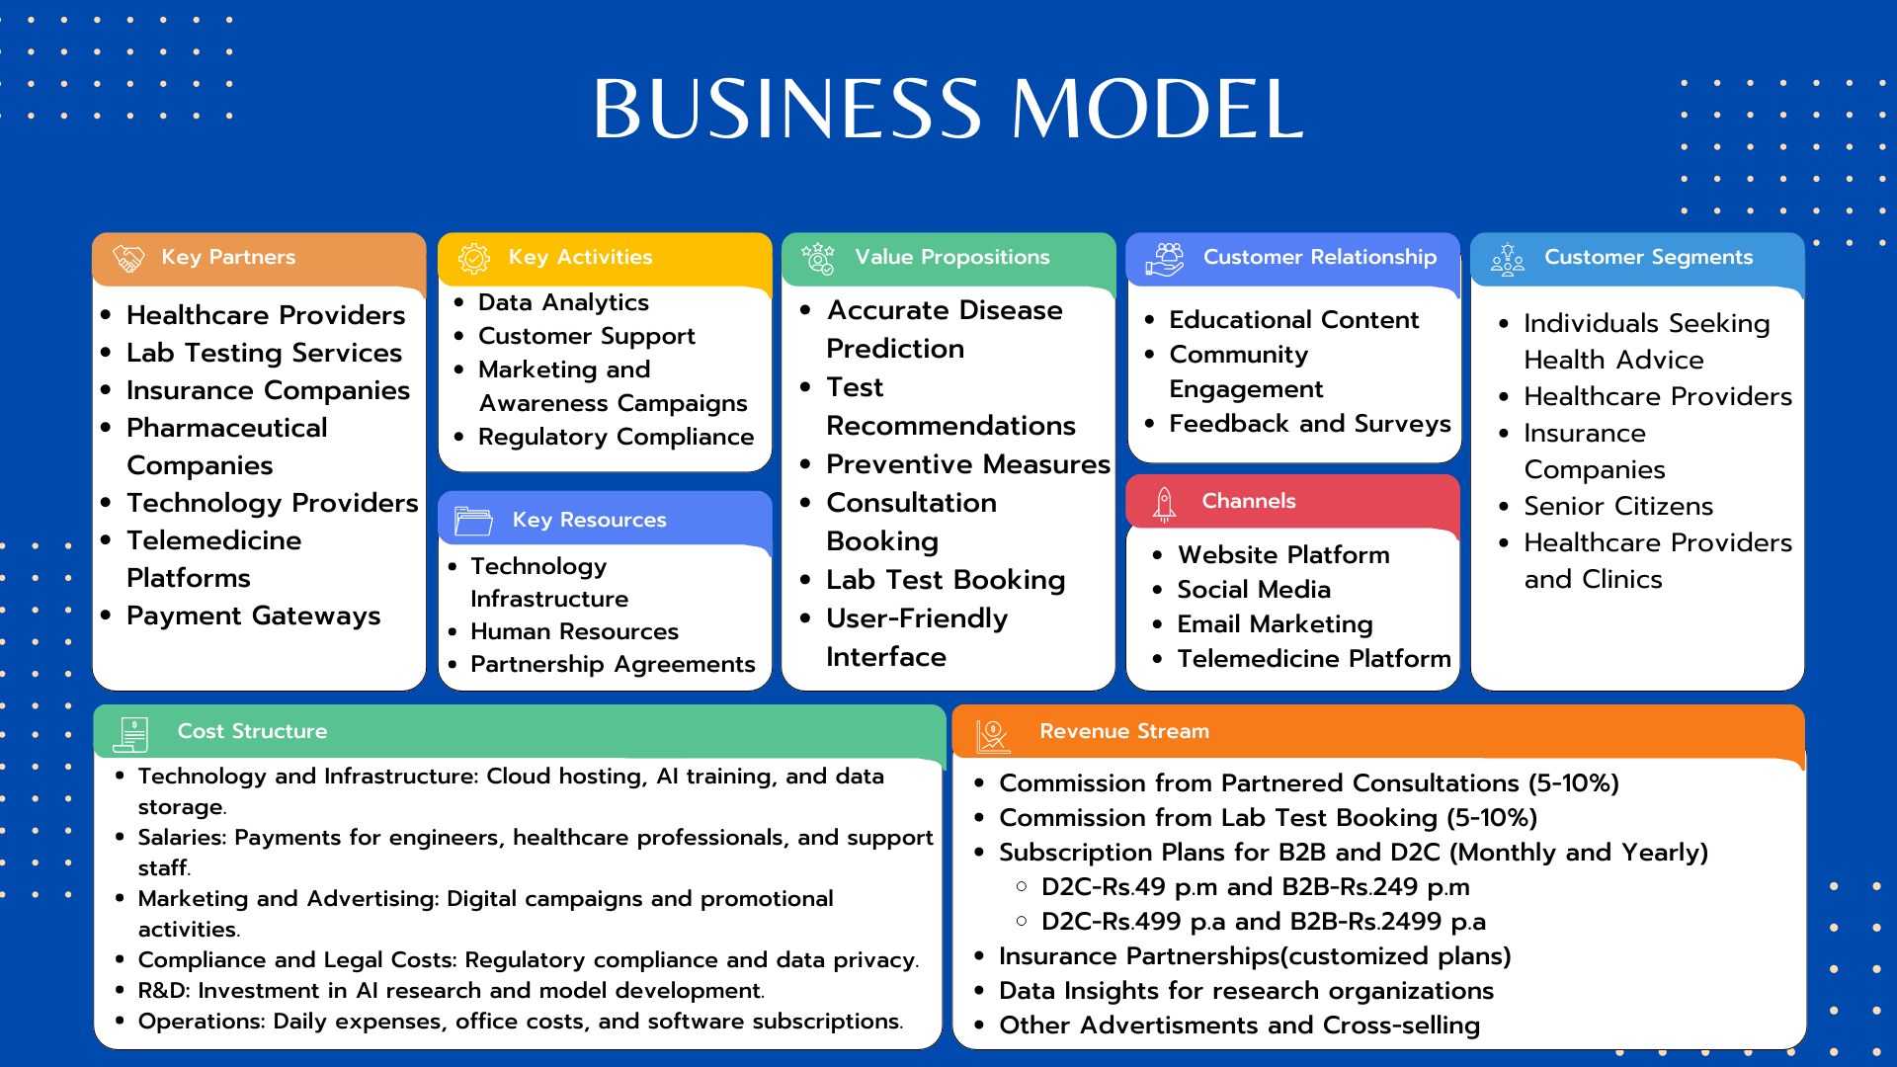

Slide 7







IMPACT AND BENEFITS
Improved Access to Healthcare Information
Early Detection and Prevention
Reduced Healthcare Costs
Enhanced Health Literacy
Data-Driven Insights for Healthcare Providers
Continuous Improvement of Healthcare Services
Social benefits: Enhanced User Experience, Inclusive Access to Healthcare, Promotion of Health Awareness
Economic benefits: Cost Reduction, Revenue Growth Opportunities, Targeted Health Marketing
Environmental benefits: Sustainable Healthcare Practices, Responsible Consumption, Support for Climate Action Initiatives

Slide 8
FUTURE SCOPE
Comprehensive Health Assessments: Include evaluations for chronic conditions and lifestyle factors for holistic recommendations.
Real-Time Monitoring: Collaborate with wearable tech companies to integrate biometric data for enhanced analysis.
Referral Networks: Establish connections to specialists based on symptom evaluations.
Partnerships: Collaborate with organizations like the WHO for global relevance.
Research Collaborations: Partner with academic institutions to utilize collected data for research.
Health Ecosystem: Partner with existing health apps to provide a comprehensive management platform.
Health Literacy Programs: Include educational modules to enhance users' understanding of health topics.
Community Forums: Establish platforms for users to connect and support each other in health management.

Slide 9
RESEARCH AND REFERENCES
GitHub repo link: https://github.com/kanakrajarora/AI-Symptom-Checker
Demonstration video link: https://youtu.be/vBhggAc2K-M
https://sdgs.un.org/goals
https://www.apollo247.com/

